Slide 1

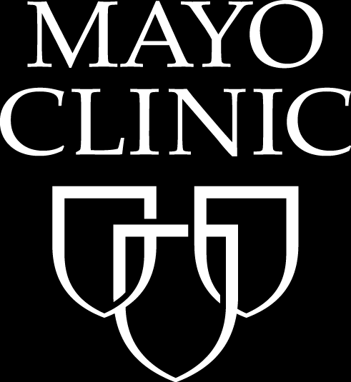
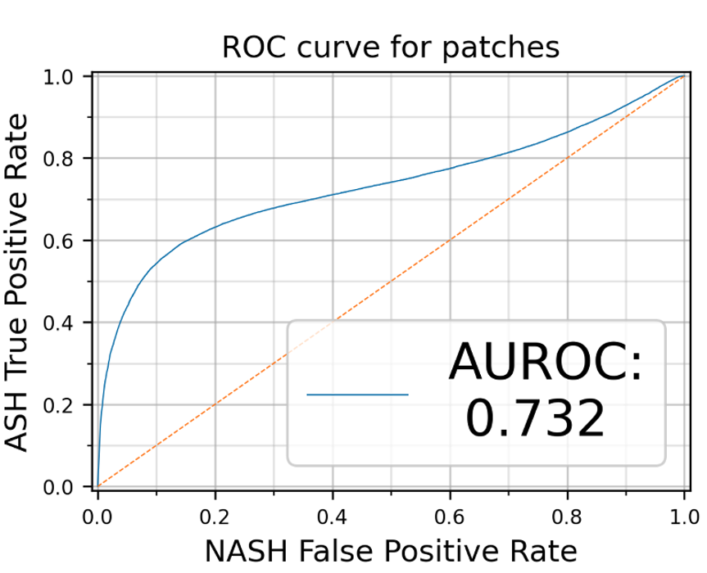
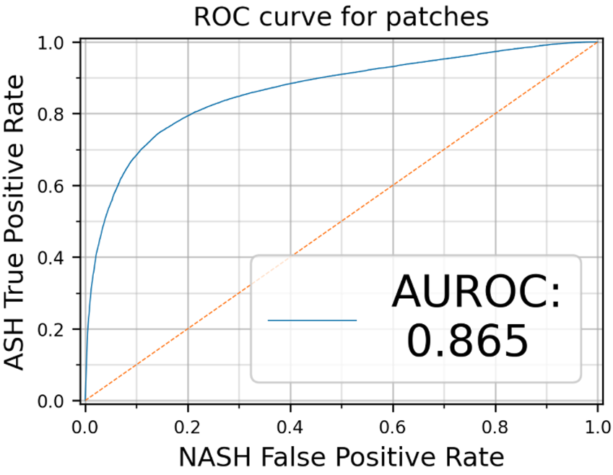
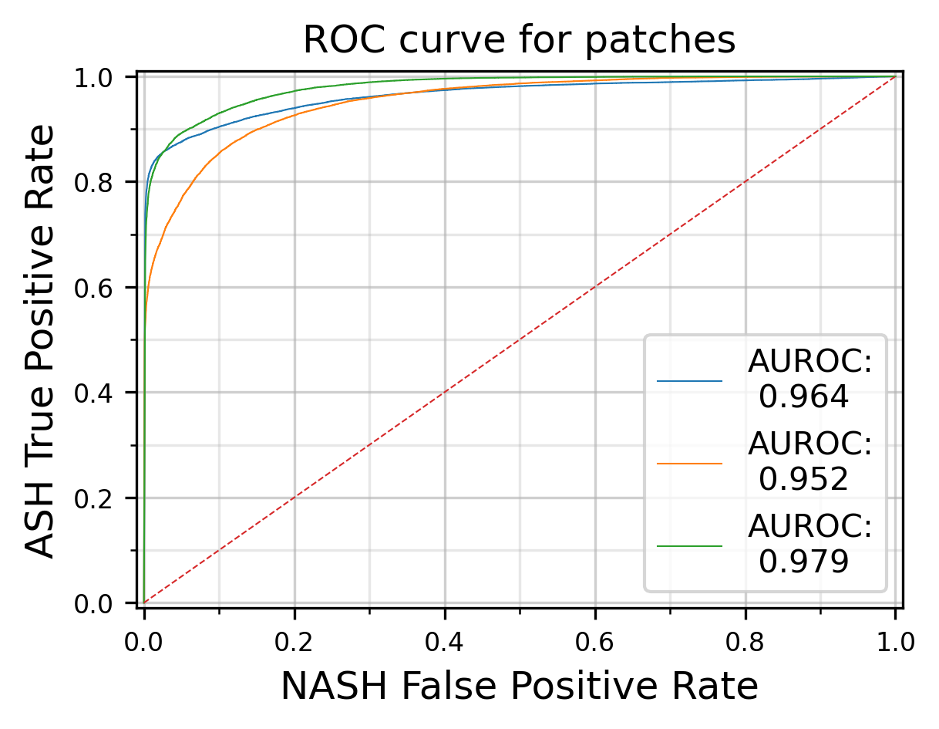
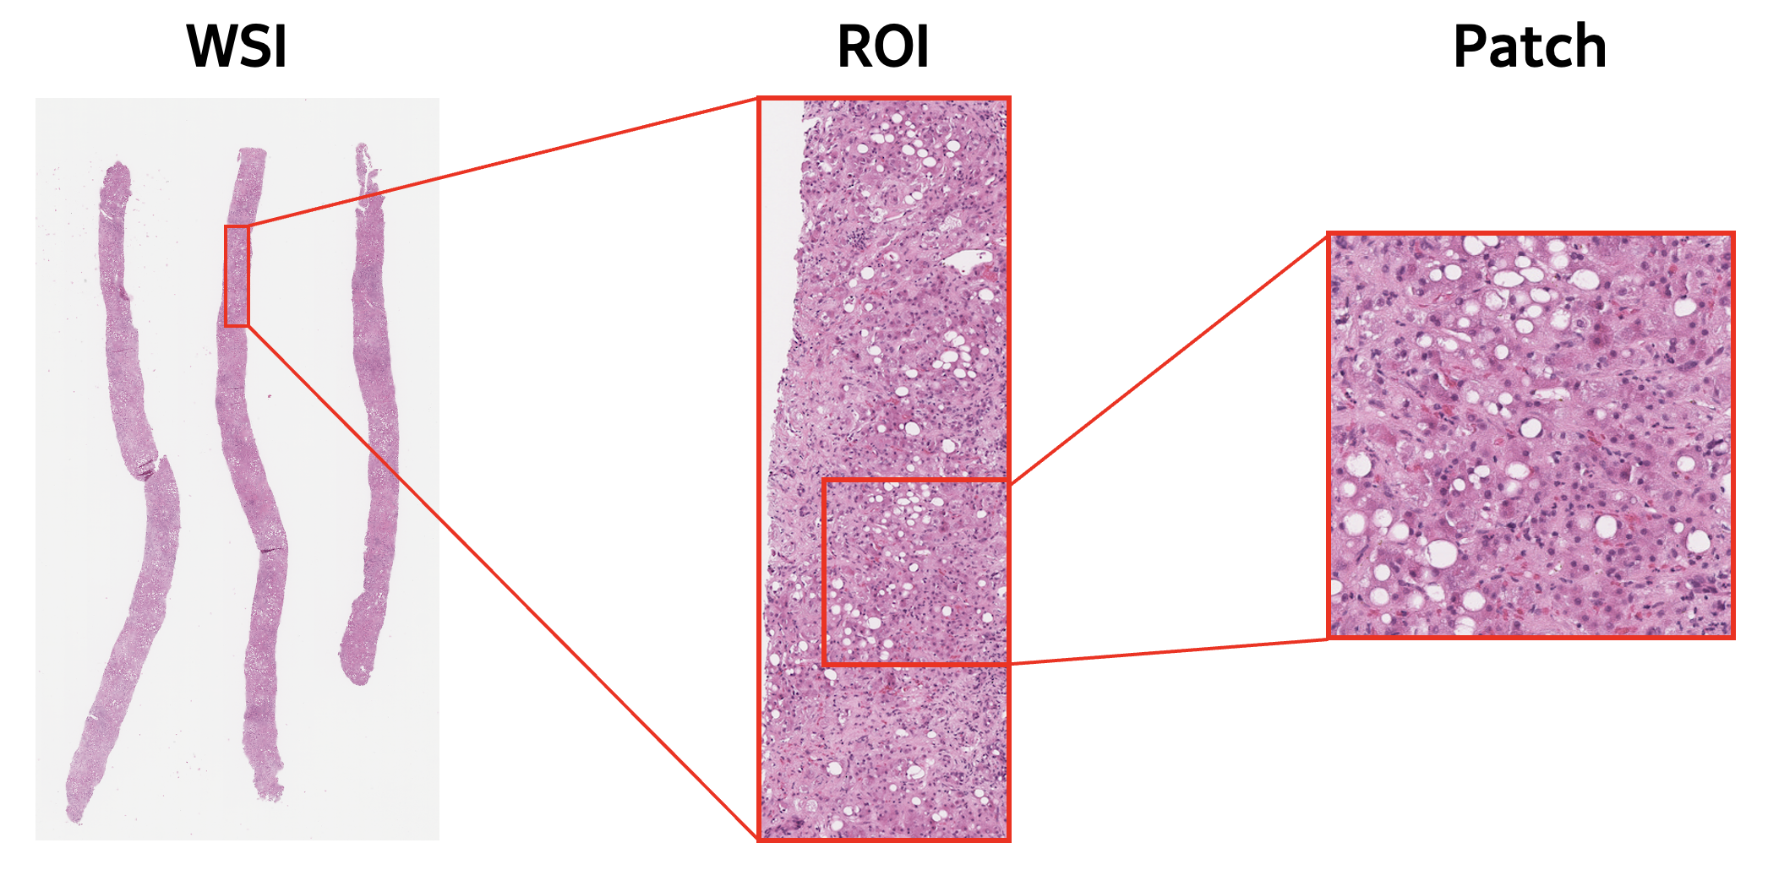
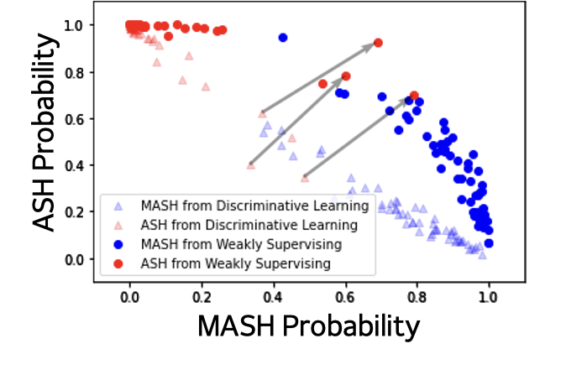
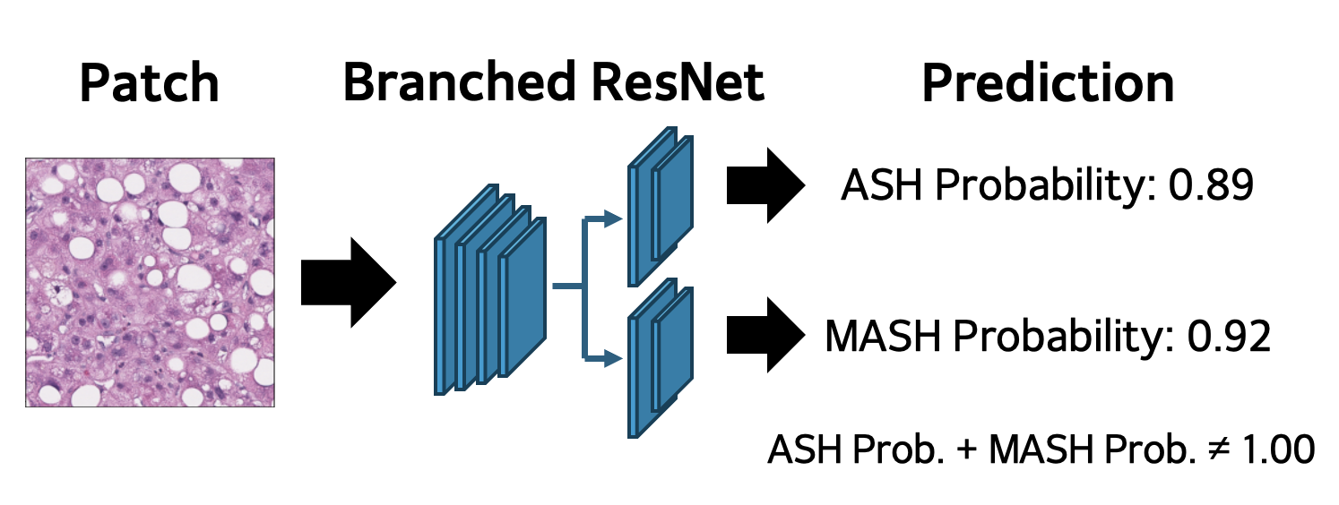
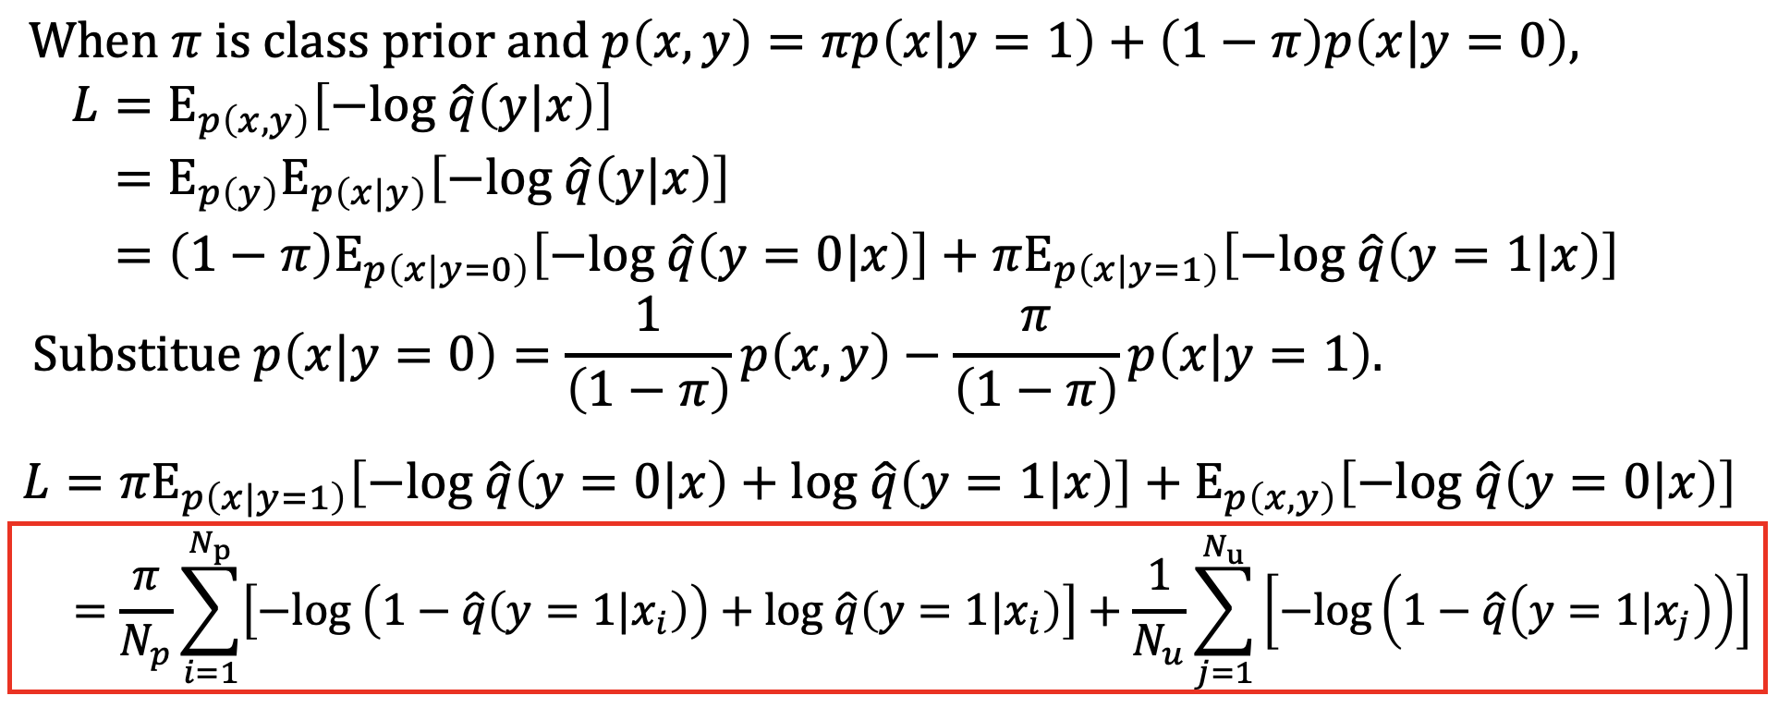
Identifying the ASH/MASH Spectrum in Liver Biopsies Using Weakly Supervising
Iljung Kim¹, Yubin Yeon¹, Yung-Kyun Noh^{1,2}, Chady Meroueh³, Joseph C. Ahn⁴,
Resham Ramkissoon⁴, Peyman Nejat⁵, Jason D. Hipp³, Hamid R. Tizhoosh⁵, Vijay H. Shah⁴
¹Department of Computer Science, Hanyang University, Seoul, Republic of Korea,
²School of Computational Sciences, Korea Institute for Advanced Study, Seoul, Republic of Korea
³Department of Laboratory Medicine and Pathology, Mayo Clinic, Rochester, MN, USA
⁴Department of Gastroenterology, Mayo Clinic, Rochester, MN, USA
⁵Department of Artificial Intelligence and Informatics, Mayo Clinic, Rochester, MN, USA
Introduction
Results
Metabolic dysfunction-associated steatohepatitis (MASH) and alcoholic steatohepatitis (ASH) are challenging to distinguish due to their overlapping histological features, making accurate diagnosis difficult.
The traditional labeling approach, which typically selects either ASH or MASH, fails to recognize the coexistence of these conditions, leading to the need for a new category, MetALD (ASH+MASH).
Algorithms need modification to identify the coexistence and to accurately locate a patient within the ASH/MASH spectrum using weak supervision.
We found some ASH slides have both ASH and MASH properties.
Figure 3. AUROC improve by changing 20 ASH labels to MASH
Objective
We assessed our model’s performance by 3 fold validation
Develop a convolution neural network (CNN) which can differentiate ASH and MASH
Identify ASH/MASH spectrum using weakly supervising learning method
Method
Obtained liver biopsy slides (ASH 150 + MASH 158)
Slides were digitalized with their diagnosis
Cropped 256x256 patches from region of interesting (ROI)
Figure 4. AUROC curve of 3 fold validation
The CNNs’ average accuracy was 91.5%
Average sensitivity – 84.6%
Average specificity – 98.1%
We trained branched CNN model using PU loss to identify ASH/MASH spectrum
Figure 1. Processing of WSI to patches for train and testing
Figure 5. Distribution difference of discriminative learning and weakly supervising
Train convolution neural network (CNN) model with patches using cross entropy loss and positive unlabeled (PU) loss
Conclusion
Our CNN-based experiment demonstrated the coexistence of ASH and MASH in patients labeled with only one, achieving 0.915 prediction accuracy for slide level classification after considering the coexistence.
PU learning with weak supervision and its output spectrum confirmed the coexistence.
Figure 2. Example of model’s prediction process.
Acknowledgements
Derivation of PU loss from cross entropy loss
Dr. Vijay Shah’s Lab (Mayo Clinic, USA)
Dr. Chady Meroueh
Dr. Joseph C. Ahn
Dr. Resham Ramkissoon
Dr. Hamid Tizhoosh’s Lab (Mayo Clinic, USA)
Dr. Peyman Nejat
Dr. Yung-Kyun Noh’s Lab (Hanyang University, Korea)
Yubin Yeon
Contact
Using PU Loss provides flexibility in model’s prediction
Iljung Kim: iljung0810@hanyang.ac.kr
Yung-Kyun Noh: nohyung@hanyang.ac.kr

Slide 2
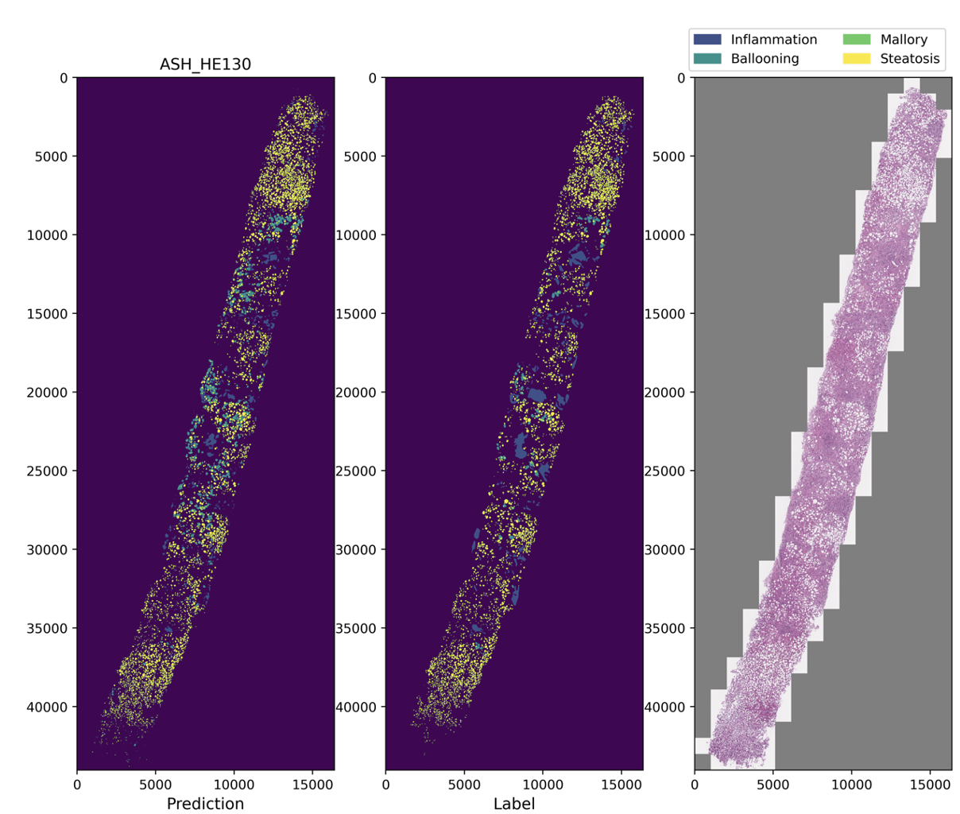
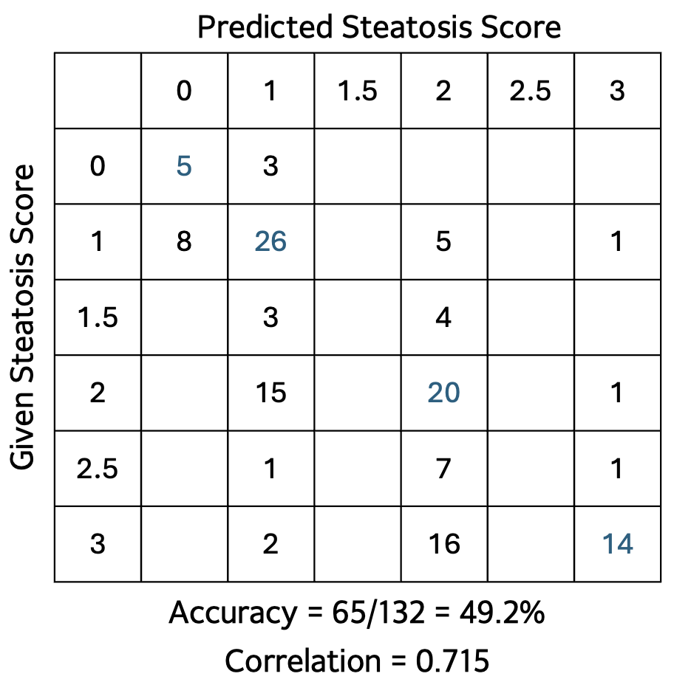
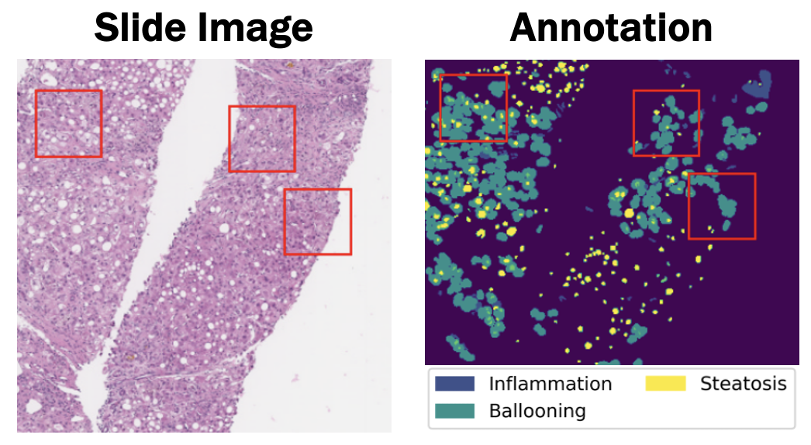
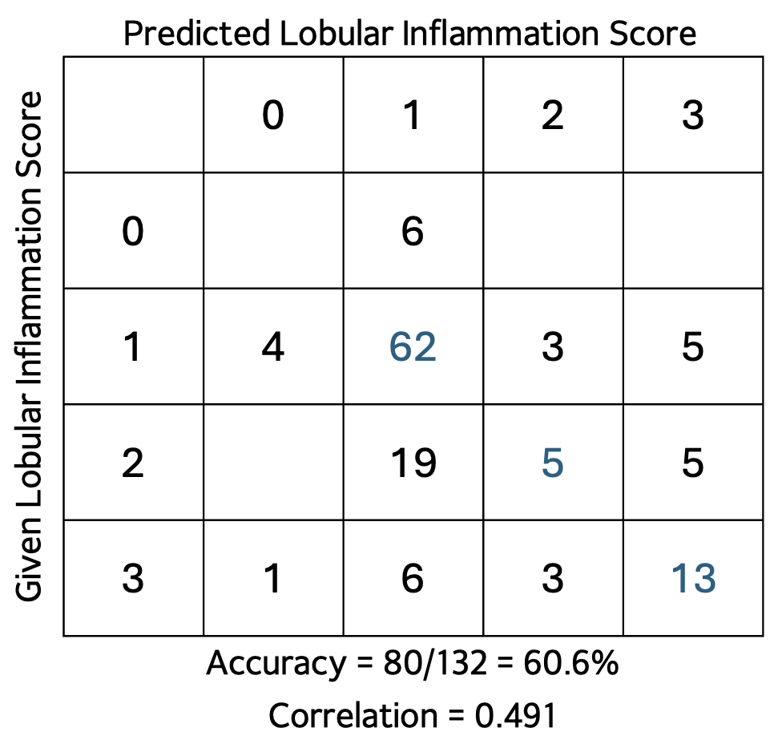
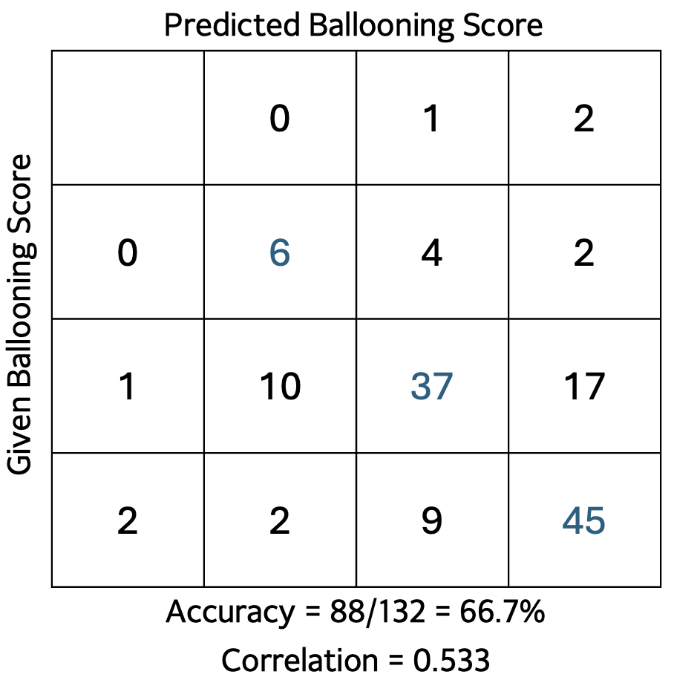
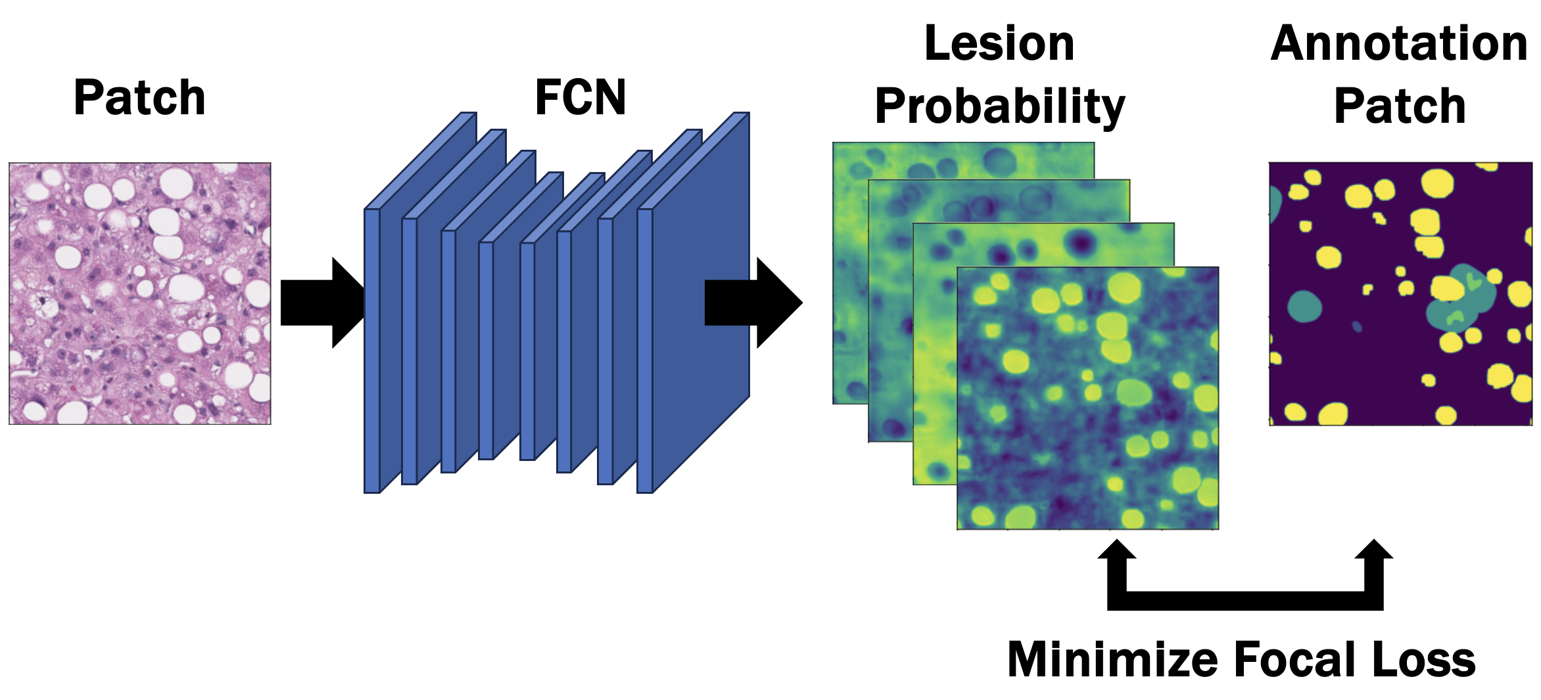
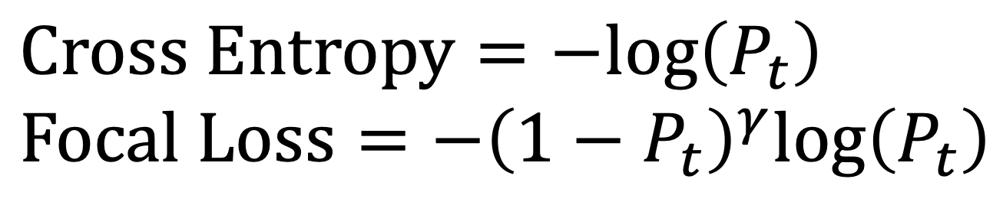
Automated NASH CRN Scoring Pipeline Through Lesion Segmentation for Alcohol-Associated Liver Disease
Iljung Kim¹, Sangwoong Yoon², Yung-Kyun Noh^{1,2}, Chady Meroueh³, Joseph C. Ahn⁴,
Resham Ramkissoon⁴, Peyman Nejat⁵, Jason D. Hipp³, Hamid R. Tizhoosh⁵, Vijay H. Shah⁴
¹Department of Computer Science, Hanyang University, Seoul, Republic of Korea,
²School of Computational Sciences, Korea Institute for Advanced Study, Seoul, Republic of Korea
³Department of Laboratory Medicine and Pathology, Mayo Clinic, Rochester, MN, USA
⁴Department of Gastroenterology, Mayo Clinic, Rochester, MN, USA
⁵Department of Artificial Intelligence and Informatics, Mayo Clinic, Rochester, MN, USA
Introduction
Results
The prevalence of alcohol-associated liver disease is increasing, and diagnosis usually relies on invasive and non-invasive methods, including liver biopsies.
The quantification of disease activity of ALD relies on scores derived from the NAFLD activity score NAS based on NASH-CRN scoring system.
There are significant inconsistencies in SLB scoring among human experts, which are considered a major issue.
Most machine learning (ML) NAS scores relies on NAFLD cases and are not sufficiently reproducible in ASH.
Objective
Develop an automated pipeline using artificial intelligence that provides a consistent NAS score for patient with ALD.
Method
Figure 3. The FCN model’s prediction and Label
Obtained liver biopsy slides
Slides were digitalized with annotations
Cropped 1024x1024 patches from region of interesting
Figure 1. Example of patch sampling
Train fully convolutional network (FCN) model with patches using focal loss
Table 1 –3. Performance of the model’s prediction
Conclusion
The demonstrated fully automated scoring system consistently provided accurate predictions for NAS scoring. Using partially annotated lesions, FCN successfully segmented most of the lesion regions, yielding robust and trustworthy results NAS scoring.
The model can even identify slides that are obviously mislabelled by human experts.
Figure 2. Processing of patch to probability prediction
Using focal loss resolves class imbalance problem
Count contour of lesions for scoring
Acknowledgements
Contact
Dr. Vijay Shah’s Lab (Mayo Clinic, USA)
Dr. Chady Meroueh
Dr. Joseph C. Ahn
Dr. Resham Ramkissoon
Dr. Hamid Tizhoosh’s Lab (Mayo Clinic, USA)
Dr. Peyman Nejat
Dr. Yung-Kyun Noh’s Lab (Hanyang University, Korea)
Dr. Sangwoong Yoon
Iljung Kim: iljung0810@hanyang.ac.kr
Yung-Kyun Noh: nohyung@hanyang.ac.kr

